Slide 1
EFFICIENT DYNAMIC ROUND ROBIN
(EDRR)

Slide 2
SOURCE CODE :
#include<bits/stdc++.h>
using namespace std;
struct round_robin
{
int at;
int bt;
int dup_bt;
int ct;
int wt;
int tat;
int pronum;
};
bool compare(round_robin a,round_robin b)
{
if(a.at<b.at)
return 1;
return 0;
}
int main()
{
int n;
cout<<"Enter number of processes :";
cin>>n;
round_robin p[n];

Slide 3
cout<<"Enter data (AT , BT) :"<<endl;
//cout<<"Process\tAT\tBT"<<endl;
for(int i=0 ; i<n ; i++)
{
p[i].pronum=i+1;
cin>>p[i].at>>p[i].bt;
p[i].dup_bt=p[i].bt;
}
cout<<endl;
cout<<"-------------------------"<<endl;
cout<<"|Process| AT\t| BT\t|"<<endl;
cout<<"-------------------------"<<endl;
//cout<<"Process\tAT\tBT\tCT\tWT\tTAT"<<endl;
for(int i=0; i<n; i++)
{
cout<<"| "<<p[i].pronum<<"\t| "<<p[i].at<<"\t| "<<p[i].bt<<"\t|"<<endl;
}
cout<<"-------------------------"<<endl;
//if arrival times aren't sorted
//Sort in ascending order of arrival times
vector<int> gantt_process;
vector<int> gantt_time;
sort(p,p+n,compare);

Slide 4
//instead of using sort function using bubble sort may help in case of already sorted processes
queue <int> ready_q;
int y=p[0].at;
gantt_time.push_back(y);
//int prev;
int ind_new;
int max_bt=0;
int index=INT_MAX,time_quantum;
set<int>s;
int q_size=0;
for(int i=0 ;i<n;i++)
{
if(p[i].at<=y && p[i].dup_bt!=0)
{
ready_q.push(p[i].pronum);
q_size++;
s.insert(p[i].pronum);
if(p[i].dup_bt>max_bt)
max_bt=p[i].dup_bt;
}
else if(p[i].at>y)
break;
}

Slide 5
int flag=0,flag_1;
while(!ready_q.empty())
{
int x=ready_q.front();
if(x!=index)
{
time_quantum=0.8*max_bt;
}
else if(x==index)
{
time_quantum=max_bt;
flag_1=1;
}
if((p[x-1].dup_bt<=time_quantum)||q_size==1)
{
if(p[x-1].dup_bt>time_quantum)
{
y+=time_quantum;
gantt_time.push_back(y);
gantt_process.push_back(x);
p[x-1].dup_bt-=time_quantum;
}
else if(p[x-1].dup_bt<=time_quantum)
{

Slide 6
y+=p[x-1].dup_bt;
gantt_time.push_back(y);
gantt_process.push_back(x);
p[x-1].dup_bt=0;
}
if(p[x-1].dup_bt==0)
p[x-1].ct=y;
}
else
{
ready_q.push(x);
q_size++;
if(flag==0)
{
index=x;
flag=1;
flag_1=0;
}
}
if(x==index && flag_1==1)
{
ind_new=1;
}
ready_q.pop();

Slide 7
if(ind_new==1)
{
index=ready_q.front();
}
q_size--;
max_bt=0;
for(int i=0;i<n;i++)
{
if(p[i].at<=y && p[i].dup_bt!=0)
{
if ( s.size() < n)
{
ready_q.push(p[i].pronum);
q_size++;
}
s.insert(p[i].pronum);
if(p[i].dup_bt>max_bt)
max_bt=p[i].dup_bt;
}
else if(p[i].at>y)
break;
}
}
float tat_sum=0.0,wt_sum=0.0;

Slide 8
for(int i=0;i<n;i++)
{
p[i].tat=p[i].ct-p[i].at;
p[i].wt=p[i].tat-p[i].bt;
tat_sum+=p[i].tat;
wt_sum+=p[i].wt;
}
cout<<endl;
cout<<"-------------------------------------------------"<<endl;
cout<<"|Process| AT\t| BT\t| CT\t| WT\t| TAT\t|"<<endl;
cout<<"-------------------------------------------------"<<endl;
for(int i=0; i<n; i++)
{
cout<<"| "<<p[i].pronum<<"\t| "<<p[i].at<<"\t| "<<p[i].bt<<"\t| "<<p[i].ct<<"\t| "<<p[i].wt<<"\t| "<<p[i].tat<<"\t|"<<endl;
}
cout<<"-------------------------------------------------"<<endl;
cout<<endl;
cout<<"*******************************"<<endl;
cout<<endl;
cout<<"Average TAT : "<<tat_sum/n<<endl;
cout<<"Average WT : "<<wt_sum/n<<endl;
cout<<endl;
cout<<"*******************************"<<endl;

Slide 9
cout<<endl<<"*****GANTT CHART*****"<<endl;
for(int i=0;i<gantt_process.size();i++)
{
cout<<"|\tP"<<gantt_process[i]<<"\t|";
}
cout<<endl;
for(int i=0;i<gantt_time.size();i++)
{
cout<<gantt_time[i]<<"\t\t";
}
return 0;
}

Slide 10
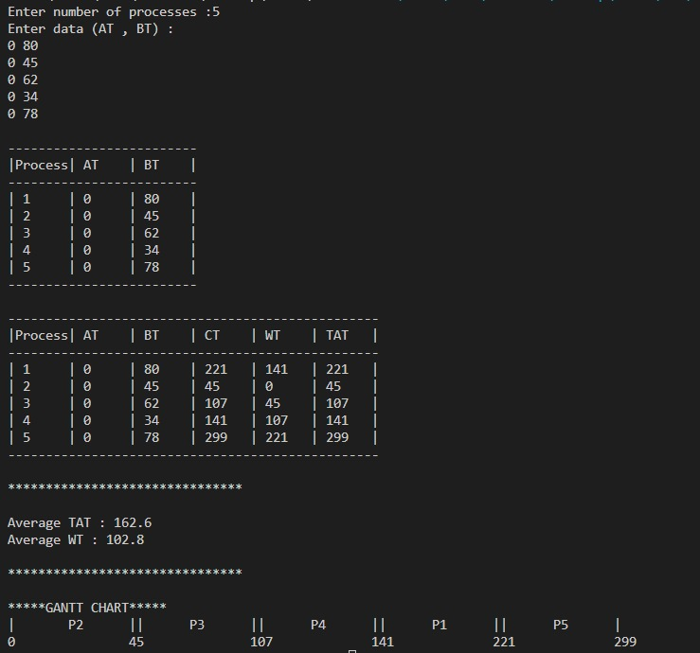
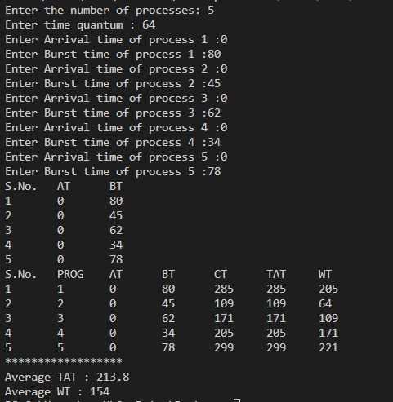
SAME ARRIVAL TIMES (EDRR V/S RRS)

Slide 11
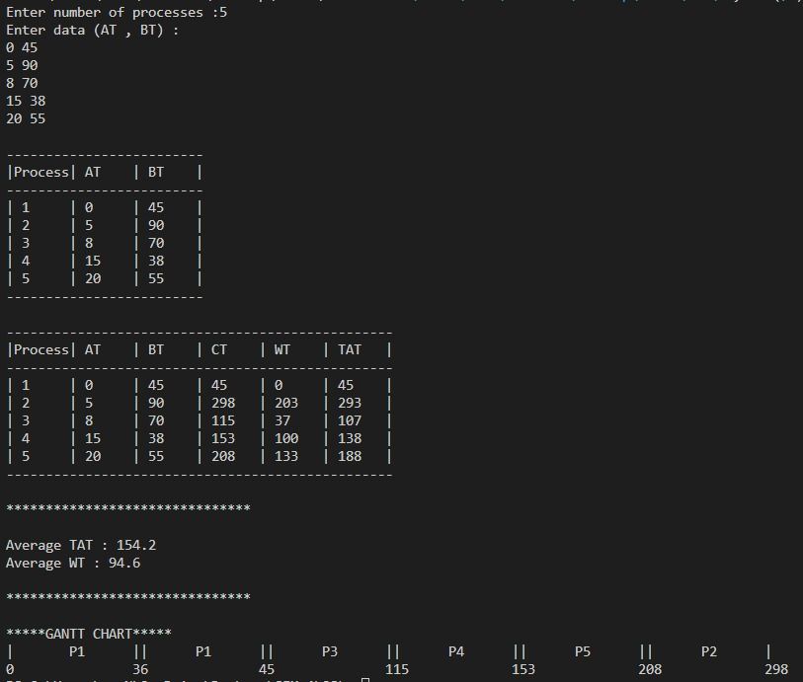
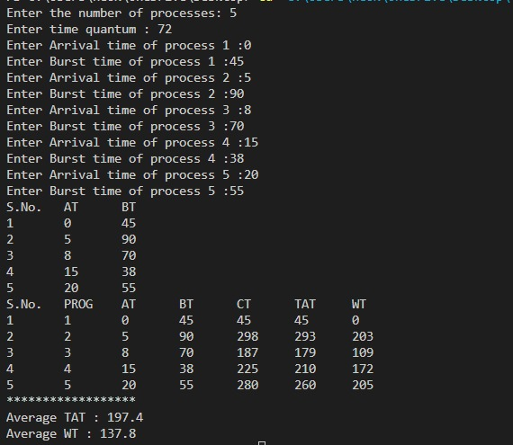
DIFFERENT ARRIVAL TIMES (EDRR V/S RRS)

Slide 12
THANK YOU

